Slide 1
COURSE MANAGEMENT
NAME : YUVANRAJ.R
REG NO : 43111087
github link :https://github.com/Yuvanraj-R/Course-Management

Slide 2
LIST OF CONTENTS
ABSTRACT
Existing system
Proposed system
Advantages
Disadvantages
Hardware requirements
Software requirements
Modules
Module description
Sample output (screenshot)
Conclusion

Slide 3
ABSTRACT
This project is a Course Management System designed to streamline the process of managing course-related information such as student details, course registration, attendance, and academic records. The system provides a centralized platform for administrators, faculty, and students to interact with course data efficiently. It improves transparency, reduces manual work, and enables better academic coordination by automating course management activities.

Slide 4
EXISTING SYSTEM
Course-related activities are handled manually.
Data is stored in physical files or spreadsheets.
Communication between faculty, admin, and students is slow and unstructured.
Errors occur frequently in maintaining records.
Difficult to track student performance or course progress in real time.

Slide 5
PROPOSED SYSTEM
Provides a centralized online platform for course and student management.
Enables easy registration, updating, and retrieval of data.
Faculty can maintain attendance and academic details digitally.
Real-time access to course-related information.
Better transparency between faculty, admin, and students.
Easy maintenance and scalability.

Slide 6
ADVANTAGES
Reduces manual workload
Saves time and improves accuracy
Easy data storage and retrieval
Real-time updates
User-friendly interface
Scalable for future modules and enhancements

Slide 7
DISADVANTAGES
Requires internet/system availability
Initial technical training required
Database failure may interrupt service
Security risks without proper authentication layers

Slide 8
HARDWARE REQUIREMENTS
Processor: Intel Core i3 or higher
RAM: 4 GB or more
Hard Disk: At least 20 GB of free space
Display: 1024 × 768 resolution or above
Internet connection for web-based access

Slide 9
SOFTWARE REQUIREMENTS
Operating System: Windows / Linux
IDE / Code Editor: VS Code / IntelliJ / Eclipse
Database: MySQL or PostgreSQL
Backend: Java / Python / Node.js
Browser: Chrome / Firefox / Edge

Slide 10
MODULES
Admin Module
Faculty Module
Student Module
Course Management
Attendance Tracking
Report Generation

Slide 11
MODULE DESCRIPTION
The Course Management System is divided into several modules that handle different responsibilities within the platform. The Admin Module allows administrators to manage users, assign courses, and configure system settings. The Faculty Module enables teachers to upload attendance, manage course materials, and track student performance. The Student Module gives students access to course information, attendance status, and announcements. The Course Management Module supports the creation and allocation of courses to respective faculty members. The Attendance Tracking Module provides digital attendance management, reducing manual errors. Finally, the Report Generation Module creates attendance and performance reports in a structured format for administrative or academic review.

Slide 12
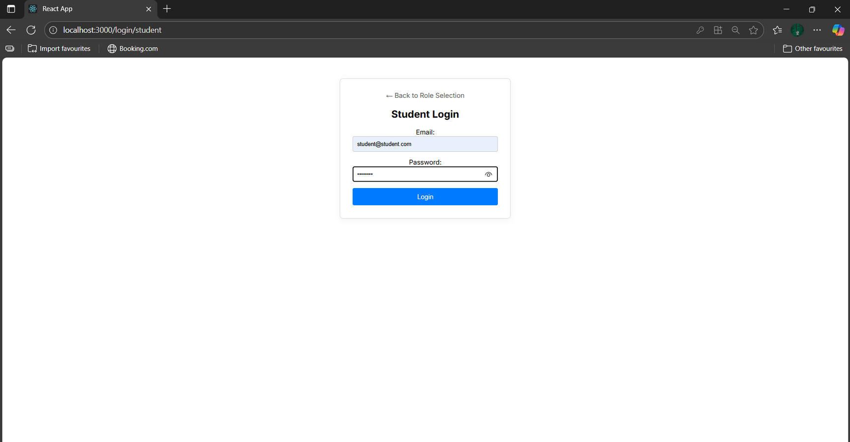
SAMPLE OUTPUT (SCREENSHOT)

Slide 13
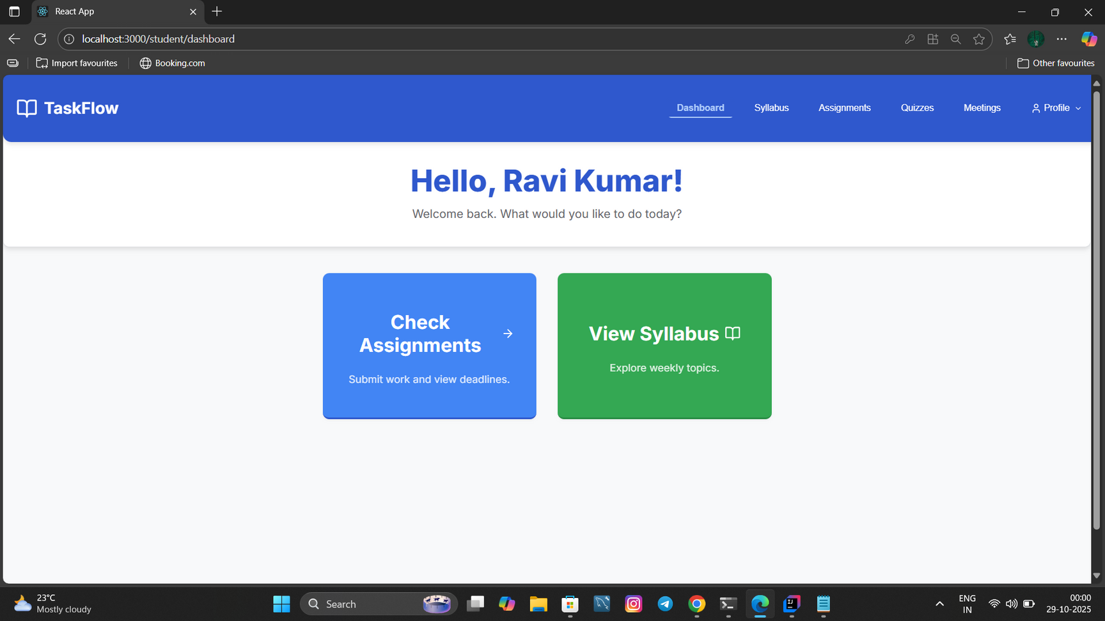

Slide 14
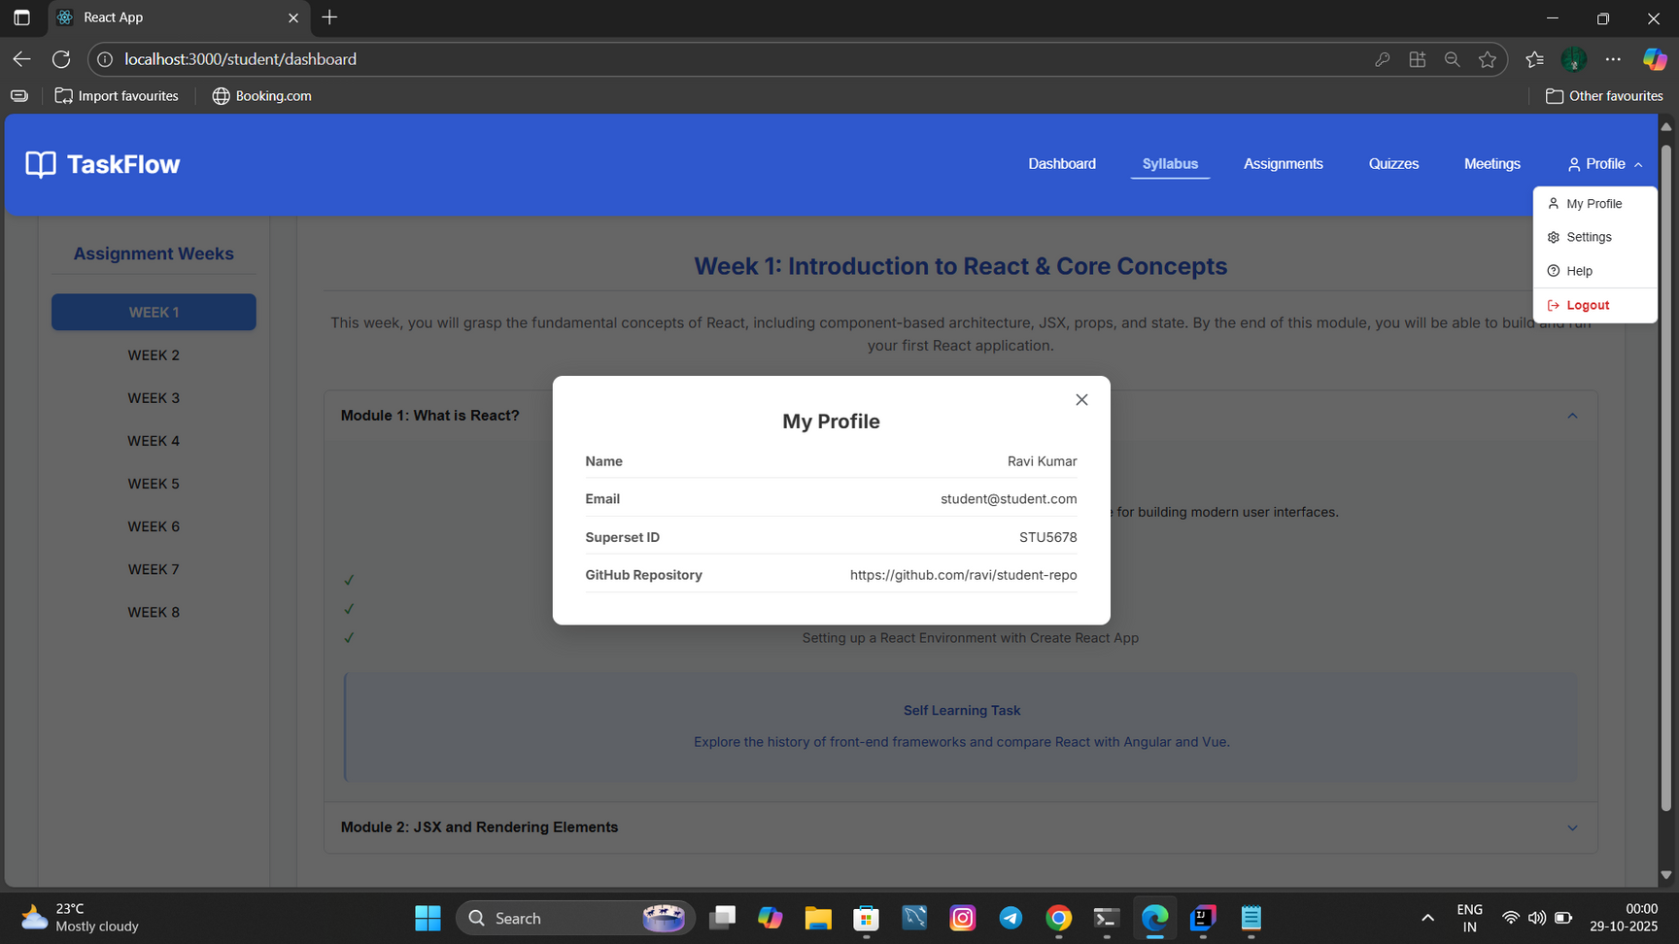

Slide 15
CONCLUSION
The Course Management System provides a simplified and automated solution for managing academic operations. It reduces paperwork, increases transparency, and ensures better coordination between students, faculty, and the administration. The system is scalable and can be enhanced further by integrating features like analytics, notifications, and AI-based performance monitoring.

